Slide 1
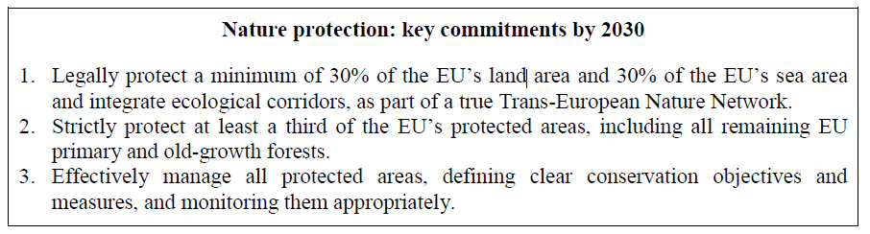
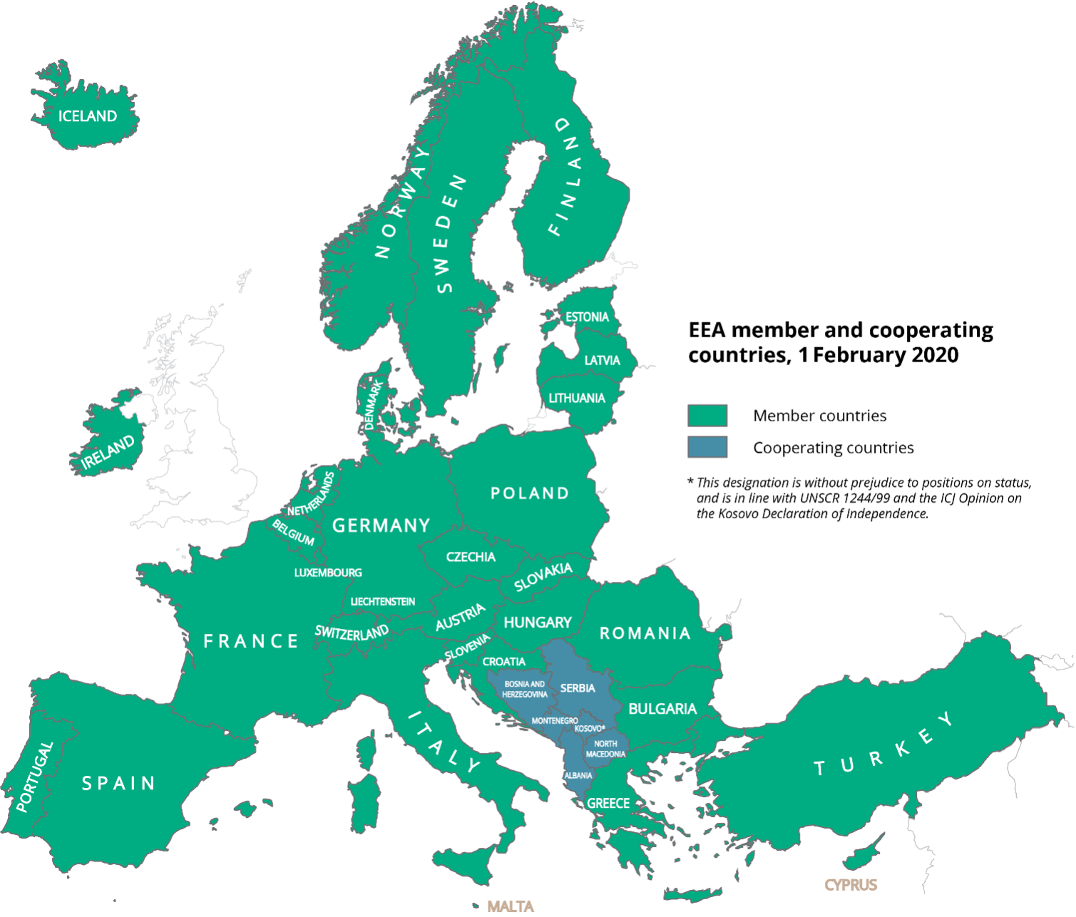
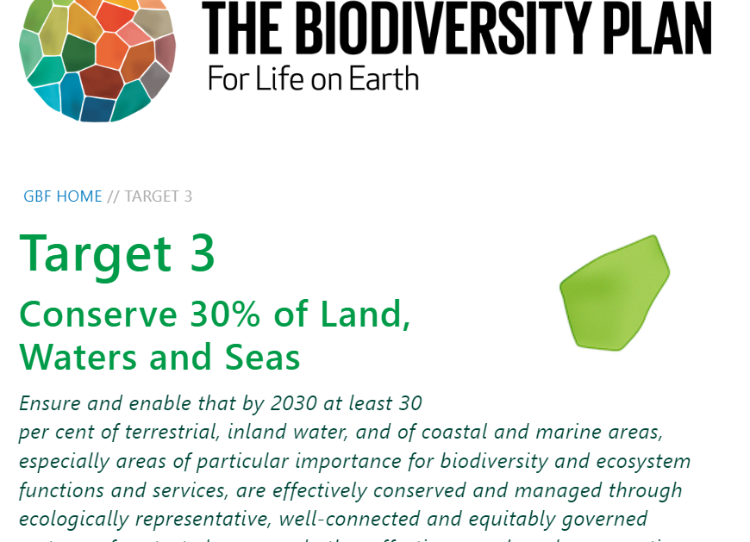
  EIONET Webinar series:
  Nationally designated areas dataflow - revision of the format to allow us to report on progress towards global and EU targets, and to include strictly protected areas
Dr Brian MacSharry, Mette Lund│12/6/2025│Webinar

Slide 2


  Agenda
Welcome to this webinar. We will cover three topics today.
    Changes to the schema
    Collection of strictly protected areas
    Collection of OECMs
Who we are:
Mette Lund
Brian MacSharry

Slide 3
  Policy setting – the “why” we are making changes.
There are two principal polices that drive these changes.
The Kunming-Montreal Global Biodiversity Framework
EU Biodiversity Strategy to 2030

Slide 4
  Changes to schema
To accommodate the requirements of these policies we need to add several attributes. In addition, we are aligning these updates to the recent updates of the standard data form (SDF) for Natura 2000. These changes will allow us to track, monitor and answer the ambitions of these policies.
We will add definitions and descriptions on the reference portal.

Slide 5
  Changes to schema – new fields (mandatory)
Global and EU target 30%: identify whether this site is to be included in assessments tracking progress towards the 30% target (made up of protected areas and OECMs).
Target 10%: identify whether this site is to be included in assessments tracking progress towards the 10% strict protected areas target.

Slide 6
  Changes to schema – new fields (Optional)
Conservation objectives (Protected areas): identify the conservation objectives for the site – select from a code list.
Conservation measures (Protected areas): identify the conservation measures for the site – select from a code list.

Slide 7
  Changes to schema – new fields (Optional)
Management plan (Protected areas): identify if a management plan for the site exists-select from a code list.
Management effectiveness (Protected areas): indicates if a management effectiveness assessment has been undertaken for this area from a code list.

Slide 8
  Changes to schema – new fields OECMs
Other effective areas-based conservation measures (OECMs):
"A geographically defined area other than a Protected Area, which is governed and managed in ways that achieve positive and sustained long-term outcomes for the in-situ conservation of biodiversity, with associated ecosystem functions and services and where applicable, cultural, spiritual, socio–economic, and other locally relevant values.“
OECMs can be counted towards the EU target if:
the area is covered by a national or international legislative or administrative act or a contractual arrangement aiming to achieve long-term conservation outcomes;
conservation objectives and measures are in place; and
effective management and monitoring of the biodiversity in the area is in place.
See COMMISSION STAFF WORKING DOCUMENT Criteria and guidance for protected areas designations

Slide 9
  Changes to schema – new fields OECMs (Optional)
OECM: identify whether the area is considered as an OECM
Conservation objectives (OECM): identify the conservation objectives for the site – select from a code list.
Supplementary information (OECM): Supplementary information concerning the recognition of the site as an OECM

Slide 10
  Strictly protected areas (EU 10% target)
To monitor progress towards policy ambitions we need to collect information on strictly protected areas. Once we have this information, we will develop indicators to track progress towards the 10% target.
!Note: strict is related to protected areas only, an OECM cannot be deemed to be strictly protected.

Slide 11
  Strictly protected areas – data collection
In some cases, an entire site will be classified as “strict”, see (A), in other cases only a portion of a site is classified as “strict”, see (B).
A
B
Boundary of
protected area
Proportion that is strictly protected
100% of the site is strictly protected.
e.g. 20% of the site is strictly protected.

Slide 12
  Strictly protected areas – data collection
How will we collect this information?
To collect these areas, we are proposing to use the “Designation Types” data flow (see Reference page )
You can submit individual sites or one single (merged) muti-polygon feature that cover the site, or portions of sites that are strictly protected.

Slide 13
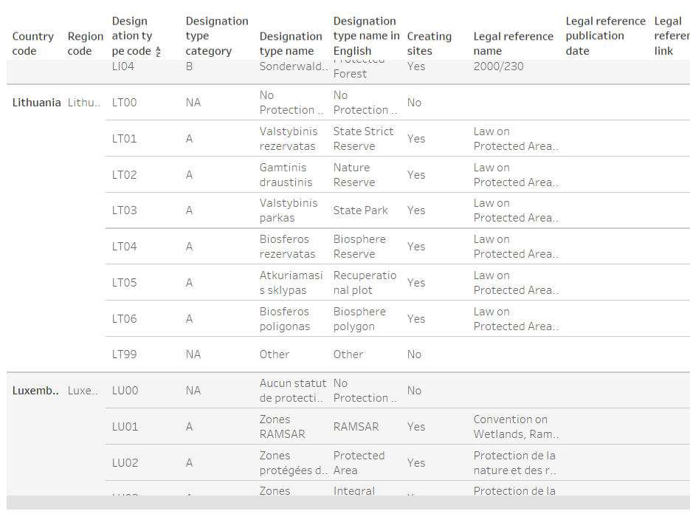
Designation Types list

Slide 14
  Strictly protected areas – data collection
To answer the policy questions, we need all portions of a sites that are strictly protected to be submitted, from an entire site to parcels within a site.

Slide 15
  Strict protected areas – data collection
How to do this?
Update the “designation type code” registry, with the code XX70 (XX being your two-digit country code), and label = “strictly protected” .
Upload the spatial boundary (or boundaries) via the nationally designated areas data flow, as usual, indicating the new designation type code in the designationTypeCode field.
The field designatedAreaType code list will be extended with "designatedStrict" and "designatedOECM" to allow for differences in mandatory fields across the tabular data (the Type 2 data).

Slide 16
The spatial data (Type 1)
Overlapping scope between INSPIRE Protected Sites and INSPIRE Area Management
IR Requirement (AM)
Annex IV, Section
11.4.3 Cross-theme requirements
If an area has been established exclusively to manage, regulate and restrict activities to conserve nature, biodiversity and cultural heritage, it shall be made available as a ProtectedSite spatial object. If a zone has been established to deliver multiple objectives, including the conservation of nature, biodiversity and cultural heritage, it shall be made available as a ManagementRestrictionOrRegulationZone spatial object.
D2.8.III.11 Data Specification on Area Management/...

Slide 17
INSPIRE Protected sites (PS) | INSPIRE Area management (AM)
geometry | geometry
inspireId | inspireId
 | environmentalDomain
 | zoneType
siteDesignation (voidable, mandatory) - designation (manatory) - designationScheme (mandatory) - percentageUnderDesignation (optional) - legalFoundationDate (voidable, mandatory) - legalFoundationDocument (voidable, mandatory)
siteName (voidable, optional) | name (voidable, optional)
siteProtectionClassification (voidable, mandatory)
thematicId (voidable, optional) | thematicId (voidable, optional)
 | beginLifespanVersion (voidable, mandatory)
 | endLifespanVersions (voidable, optional)
 | competentAuthority (voidable, mandatory)
 | designationPeriod (voidable, mandatory)
 | specialisedZoneType (voidable, optional)
 | legalBasis (voidable, mandatory)
 | relatedZone (voidable, optional)
 | plan (voidable, optional)
Comparison between INSPIRE Protected Sites and INSPIRE Area Management

Slide 18
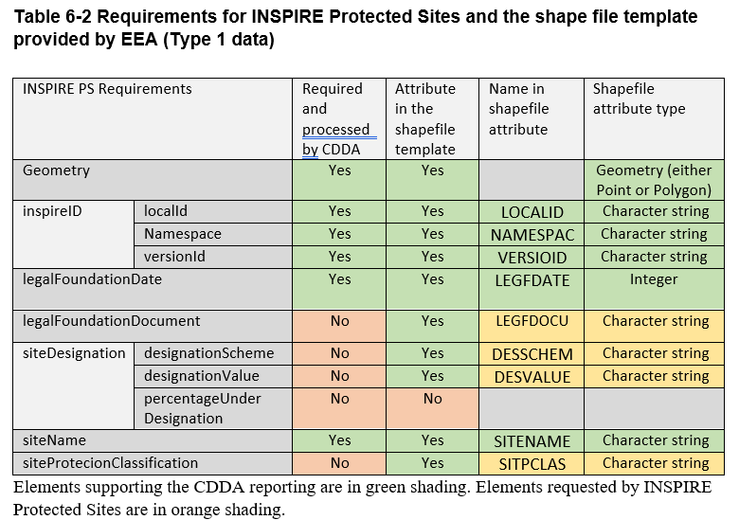
Mapping table from the current Reporting guidelines available at the Reference page
We are preparing updated versions for new INSPIRE PS and AM.
NOTE the table shows INSPIRE PS v4, which is now outdated

Slide 19
Useful INSPIRE links
INSPIRE Consolidated UML data model
https://inspire-mif.github.io/uml-models/approved/html/
Protected sites Version 4.0
https://github.com/INSPIRE-MIF/application-schemas/tree/main/schemas/2025.1/ps/4.0
Protected sites Version 5.0
https://github.com/INSPIRE-MIF/application-schemas/tree/main/schemas/2025.1/ps/5.0
Area management Version 4.0
https://github.com/INSPIRE-MIF/application-schemas/tree/main/schemas/2025.1/am/4.0

Slide 20
  Questions?
Do you have any questions for us?
The reference portal and Reportnet 3 will be updated with descriptions, definitions, accepted values, etc.
Brian.MacSharry@eea.europa.eu
Mette.Lund@eea.europa.eu

