Slide 1
Habitats and species Art. 17 reporting
Reportnet 3 walkthrough
© Frank Vassen
Jonathan Maidens & Eleni Tryfon / Webinar 12 March 2025

Slide 2
Art. 17 in Reportnet 3 - Agenda
Introcuction to basic functionalities of Reportnet 3.0 (new version) for Art 17 dataflow - most functionalities valid also for Art. 12
Q&A
Meeting duration 2 hours
The meeting will be recorded
Recording and presentation will appear in the Art 17 reference portal https://cdr.eionet.europa.eu/help/habitats_art17 along with other material relevant to Art. 17 reporting
Questions on the functioning of the platform should be addressed to the helpdesk nature.helpdesk@eionet.europa.eu

Slide 3
Reporting process
preparation of the data
submission
validation
correction and re-submission based on the feedback of the validation
These steps should be repeated until the data has achieved the required quality and the delivery can be finalised
- delivery

Slide 4
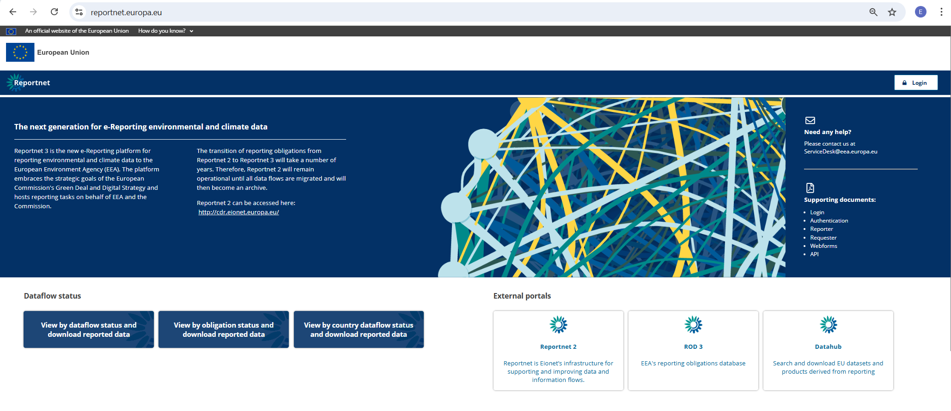
Reportnet 3

Slide 5
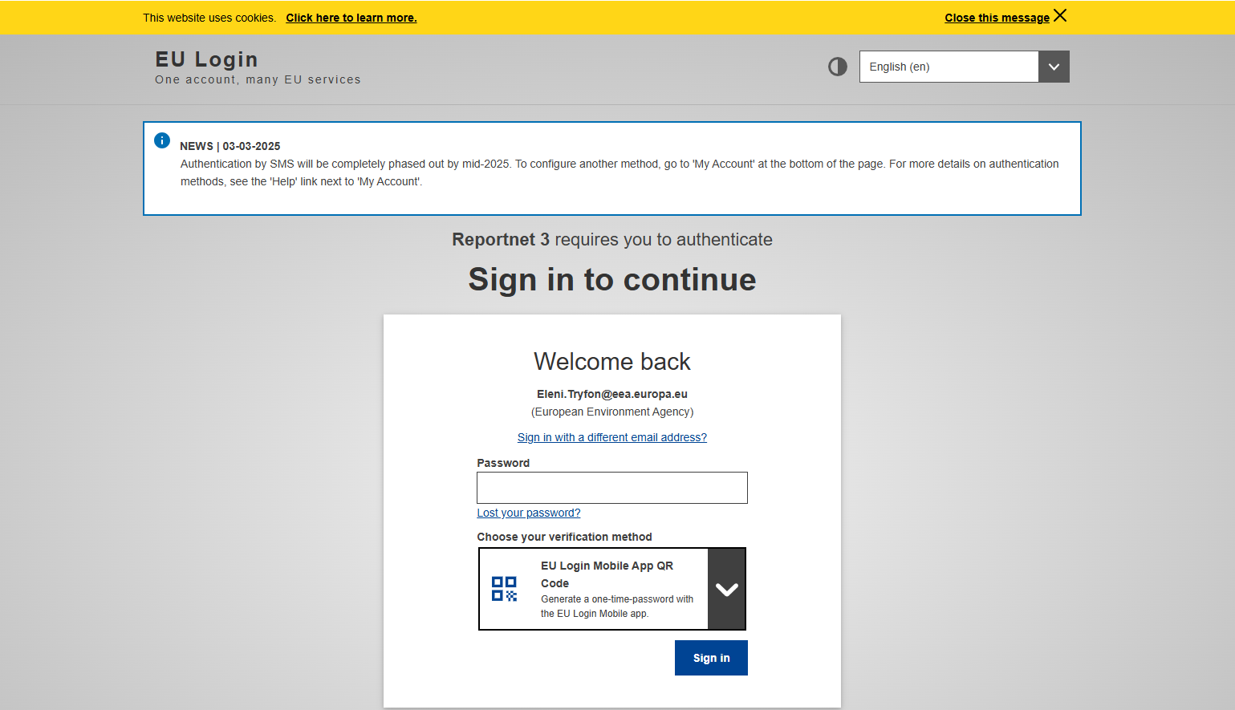
Guidance on getting EU Login and registering to the platform can be found in the Supporting documents on the main page
https://reportnet.europa.eu/
Lead reporters can internally designate additional national reporters on the platform
Lead –additional Reporters are advised to log in to Reportnet 3 before they are assigned to a dataflow
By default Eionet national data coordinators have reading rights to all national dataflows

Slide 7
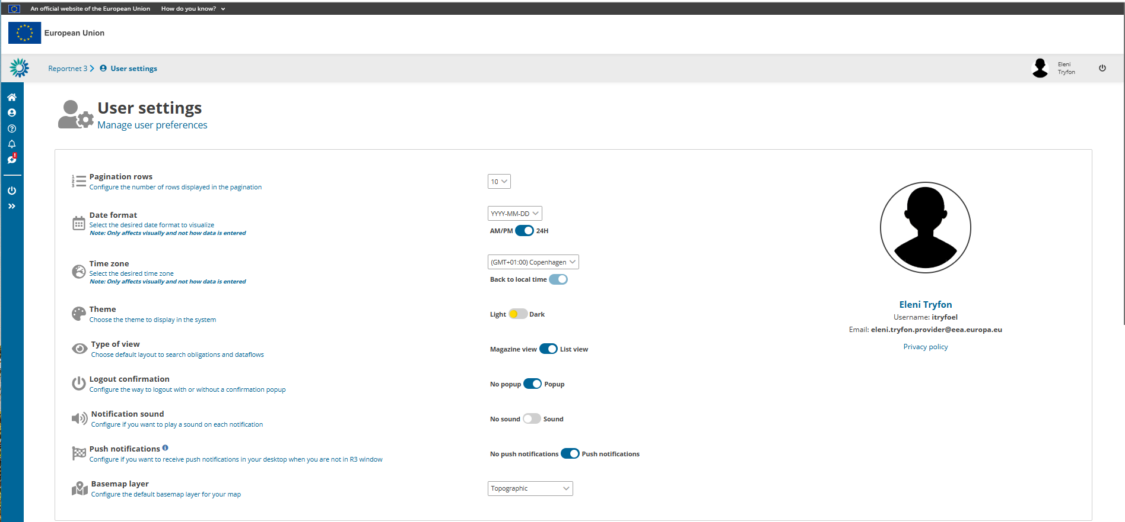

Slide 10
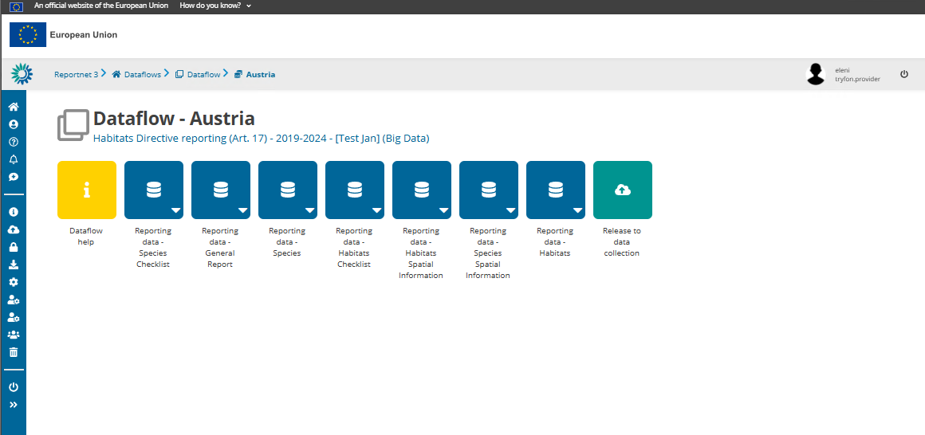
A lead reporter can add additional reporters. They must have logged into Reportnet 3. Additional reporters cannot add other reporters or release the data.

Slide 11
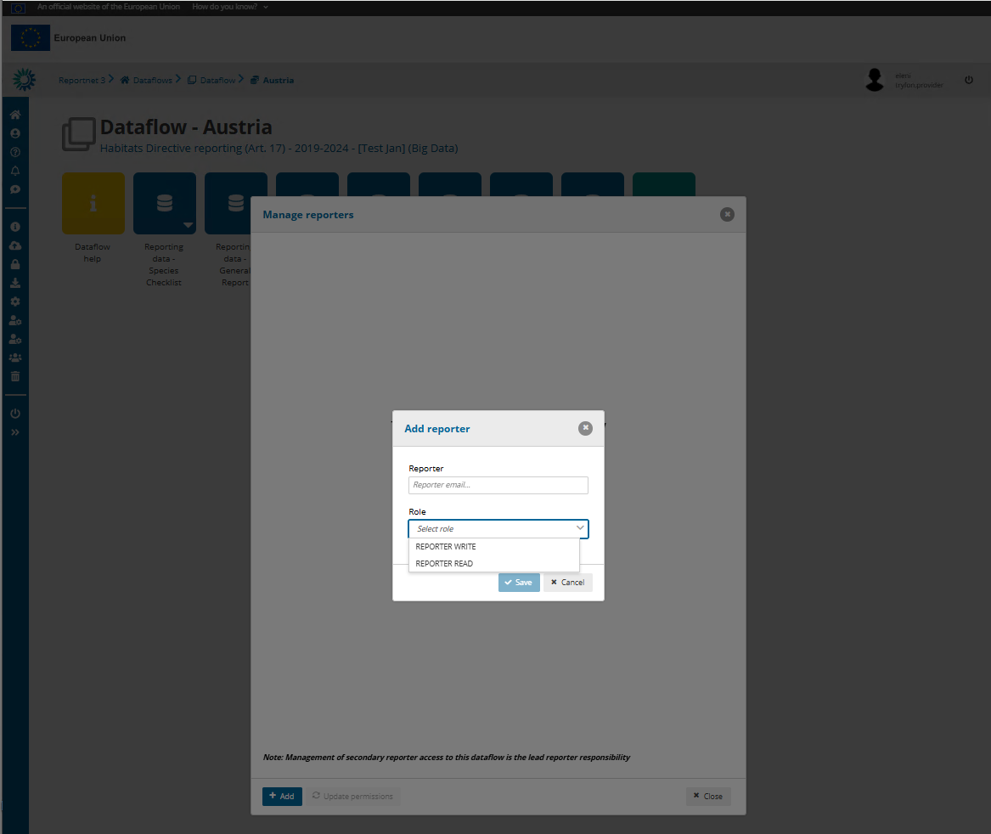

Slide 12
Several reporters can work in parallel in the platform
Good coordination is needed, particularly with regard to importing tables and validating

Slide 14
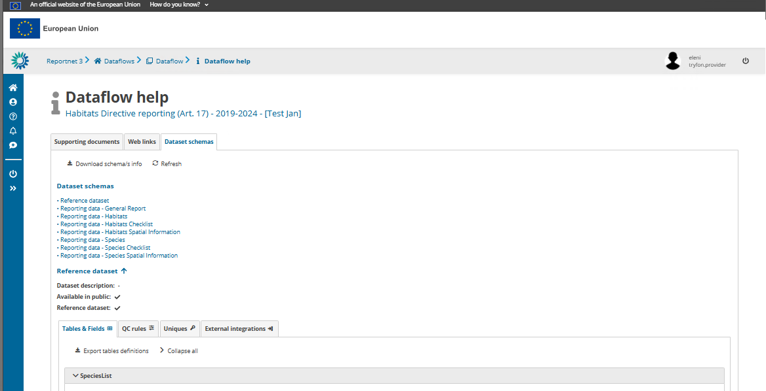
Info on mandatory / non-mandatory tables and required fields and validation rules

Slide 16
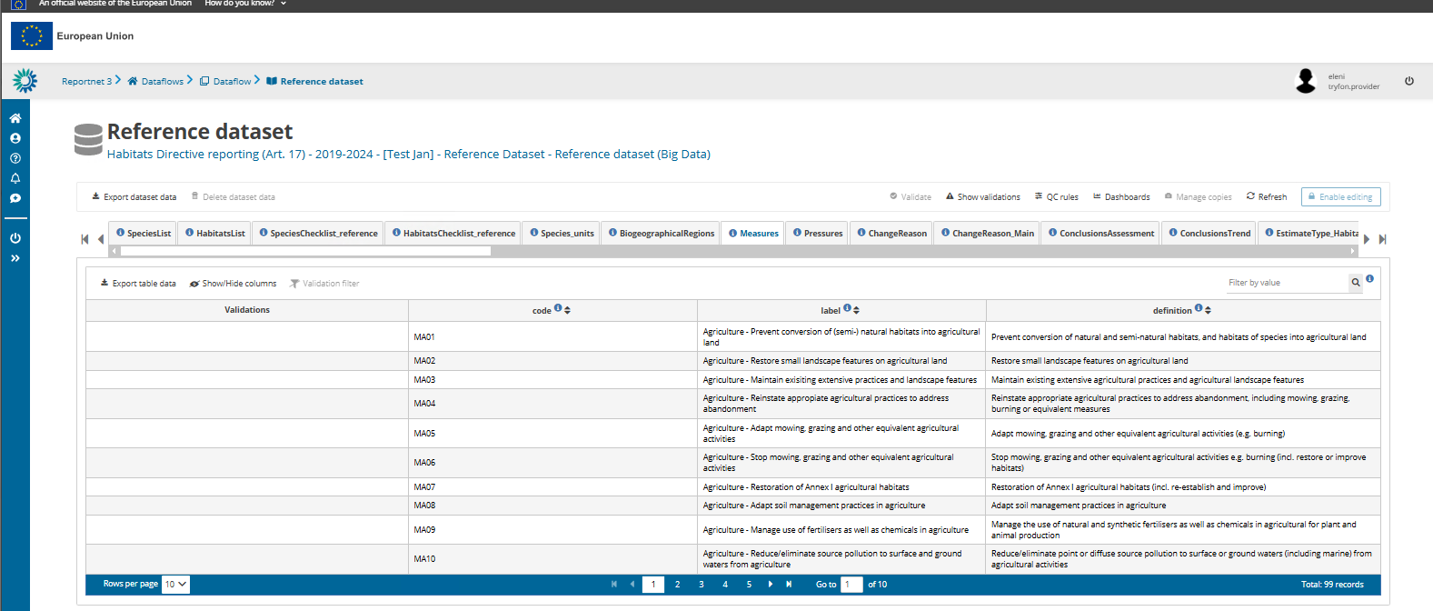

Slide 17
Reporting data

Slide 19
Work offline and import data
Export empty template in Excel format

Slide 20
All the schema structures and validation rules must be fully considered when preparing data
Disregarding this can result in mistakes that must be rectified before the data is delivered
The same applies to the code lists considered
While working offline the use of the Extended Import Template is recommended
Extended Import templates are also available in the Reference Portal

Slide 21
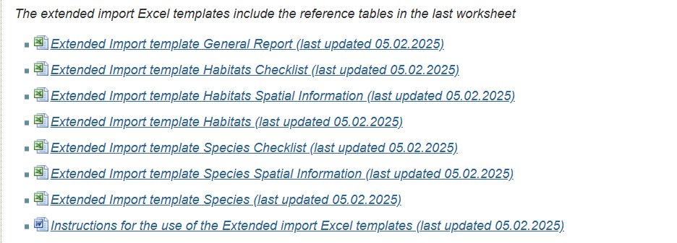
Extended Import Templates
Drop-downs with reference codes, available when pressing the fields with reported values
(_refLabel): labels of the reference codes appear. Available only for species, habitat codes, pressures, measures
: reference codes directly applicable
Light red colour code (_mv): reference codes that can be copy-paste in the light purple multi-select reporting fields, separated by semi colon and no space
Art. 17 Reference Portal
An additional spreadsheet includes all relevant reference codes and labels
Import the extended import templates – the redundant columns and spreadsheets are automatically excluded from the import
Updated reference value in the trend magnitude pre-defined ranges (-100to-51 instead of -100to-50) – new Templates available for Species and Habitats

Slide 22
Work offline and import data
Import dataset data

Slide 23
Work offline and import data
..... or import table data (in csv)

Slide 24
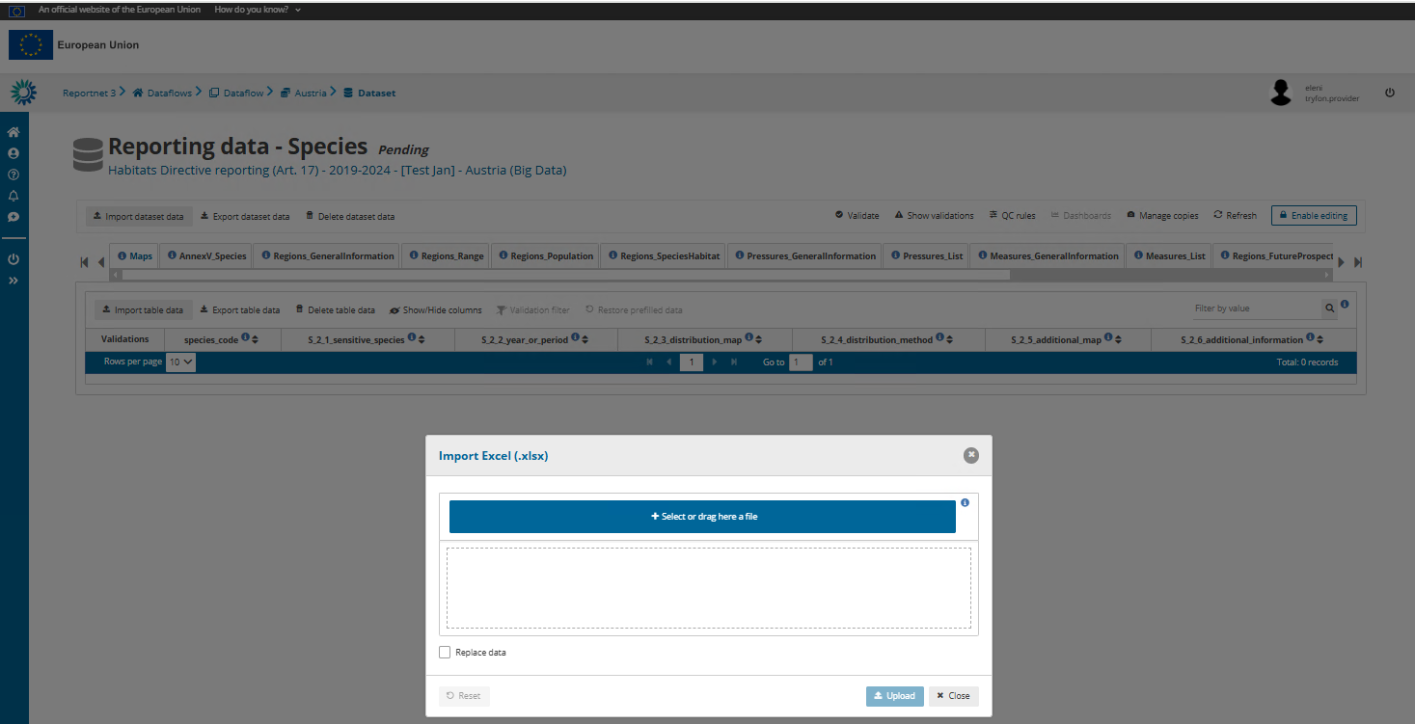

Slide 25
Work online
The function “Enable editing” must be activated to edit and manually enter data in Reportnet 3

Slide 26
Work online
To import data you need to Disable editing

Slide 27
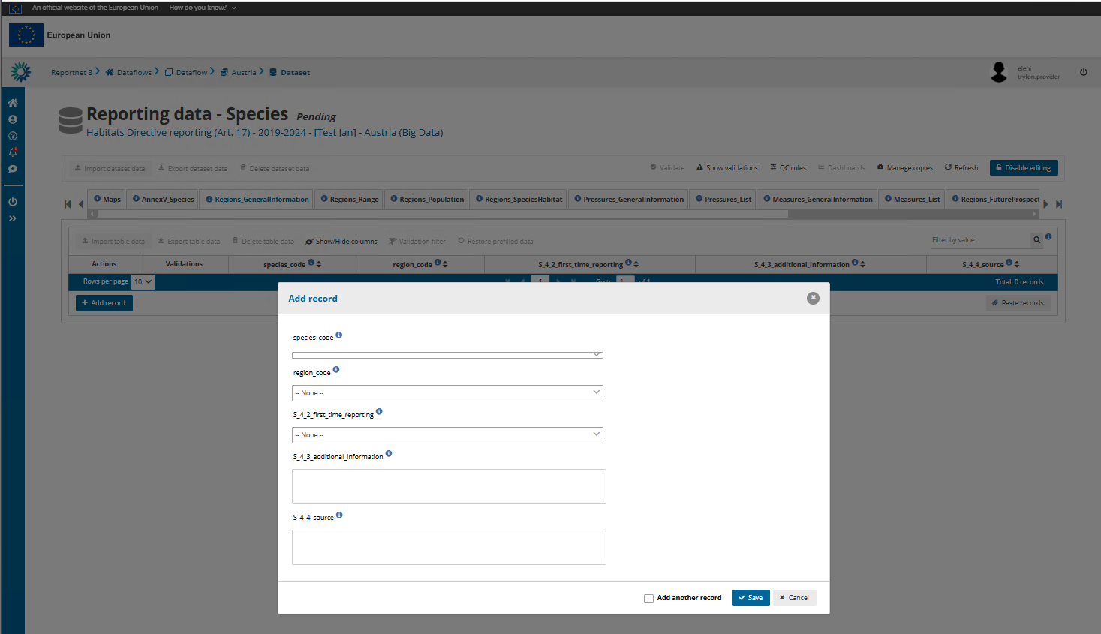

Slide 28
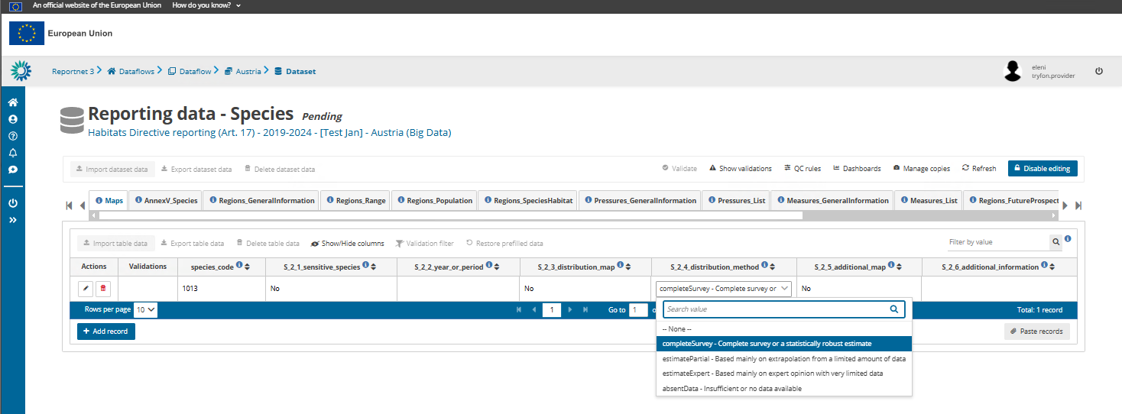
Work online

Slide 29
Art. 17 Checklist schemas

Slide 30
Functionality of importing the final Member State Art. 17 Checklist (version available in the Reference Portal) is provided
As a first step check, amend (if necessary) and validate the national species and habitats checklists

Slide 31
Refresh to see the data

Slide 32
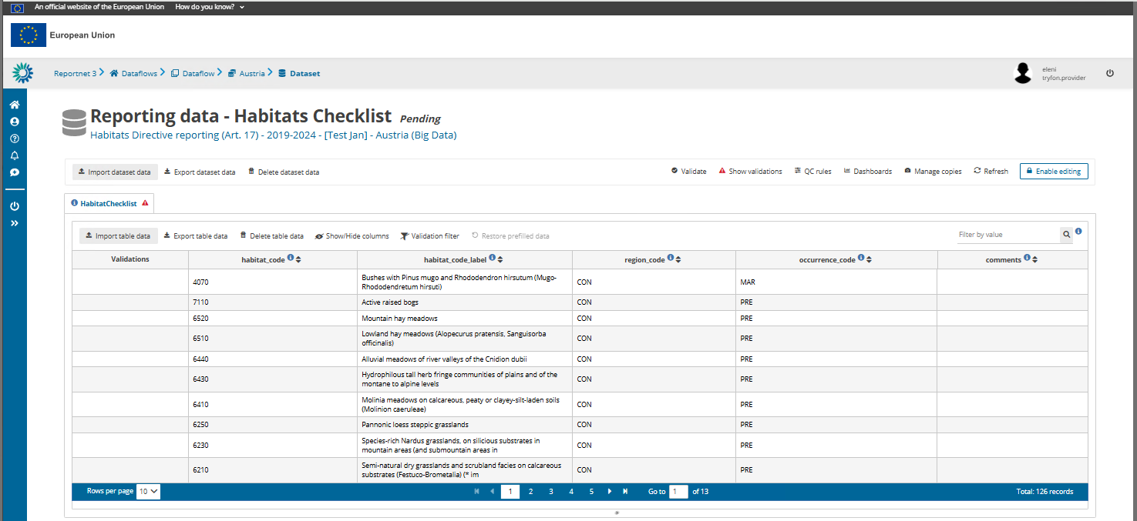
Code labels for habitats and species in checklists are editable and are not validated. They are only for the ease of work of reporters

Slide 33
The checklist can be updated while reporting
(though we recommend to do so only when absolutely necessary)
Flag species / habitats – region combinations for deletion by selecting in the occurence_code ‘DEL’
Add new species / habitats – region combination
Modify information in occurence_code
Information on reason behind any change in the field ‘comments’ is mandatory otherwise a delivery is blocked
In Art. 17 species Checklist
Select the appropriate species population_size_unit
For invertebrate and non-vascular plant species present in one single country, indicate the population unit from the corresponding reference table (it is not pre-filled)
For the vascular plant species where more than one population unit is proposed (i.e. i or m2), one of those units must be selected for reporting
For species that you will not report (e.g. OCC), fill NA
If the population size unit is not filled in, validations will produce blockers.
Mandatory species and habitats to be reported are those specified in the Explanatory Notes
All mandatory features should be reported apart from those flagged for deletion (DEL) in the country checklist
Reporting non-mandatory features is left to MS. Any non-mandatory feature reported should comply with the validation rules and blockers

Slide 34
Spatial information schemas

Slide 35
The spatial data may be imported as table with the grid cell codes and feature codes, or in shapefile, or geopackage formats

Slide 36
Validations

Slide 37
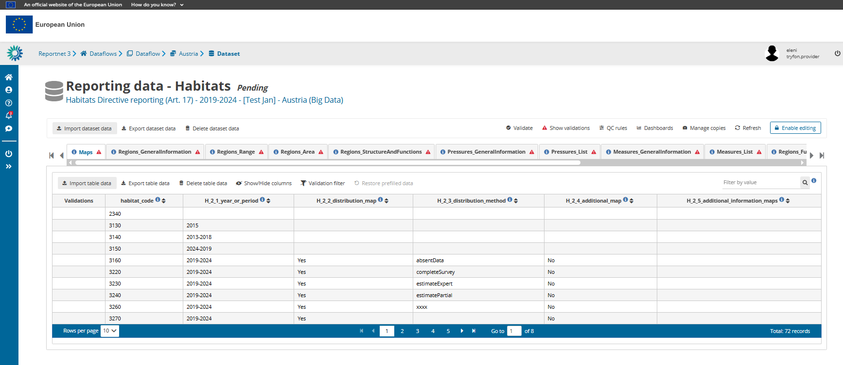

Slide 38
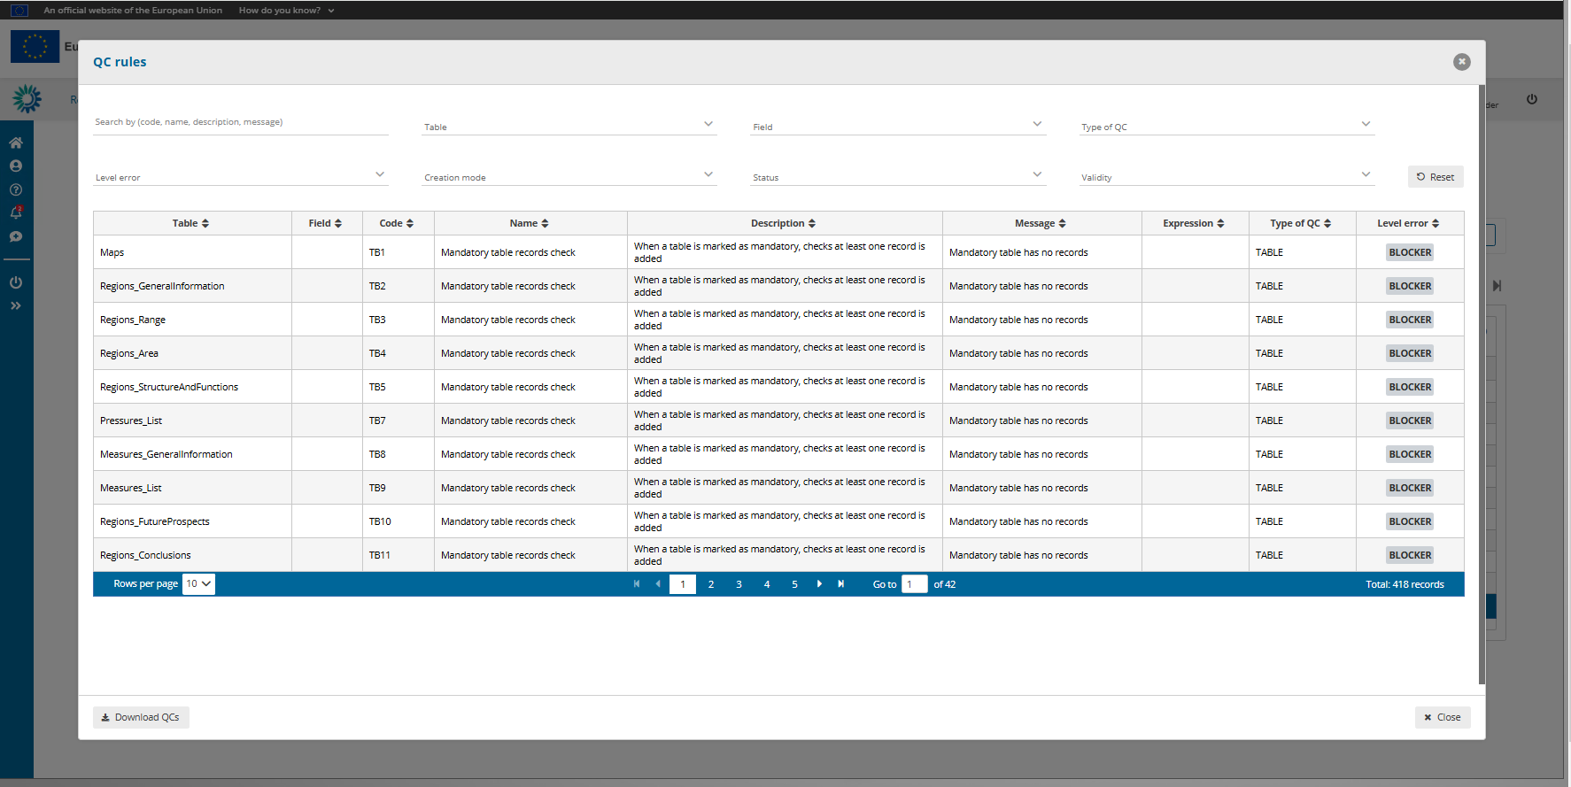

Slide 39
To validate, the ‘Enable editing’ must be disabled

Slide 40
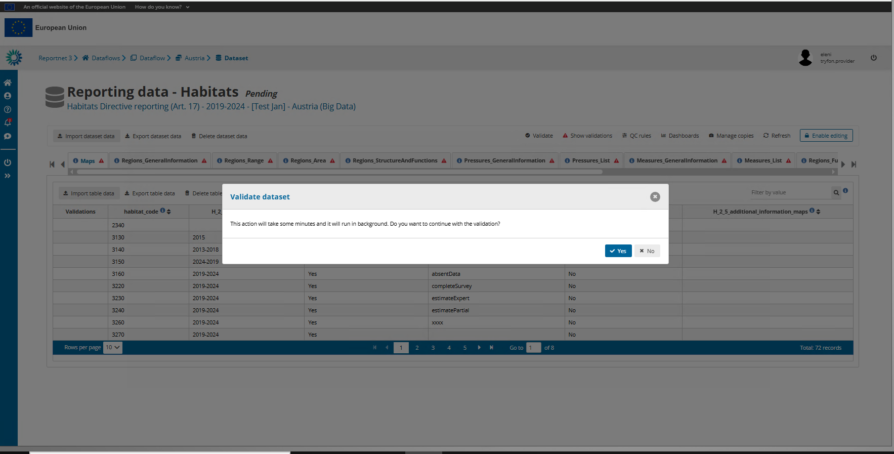

Slide 41
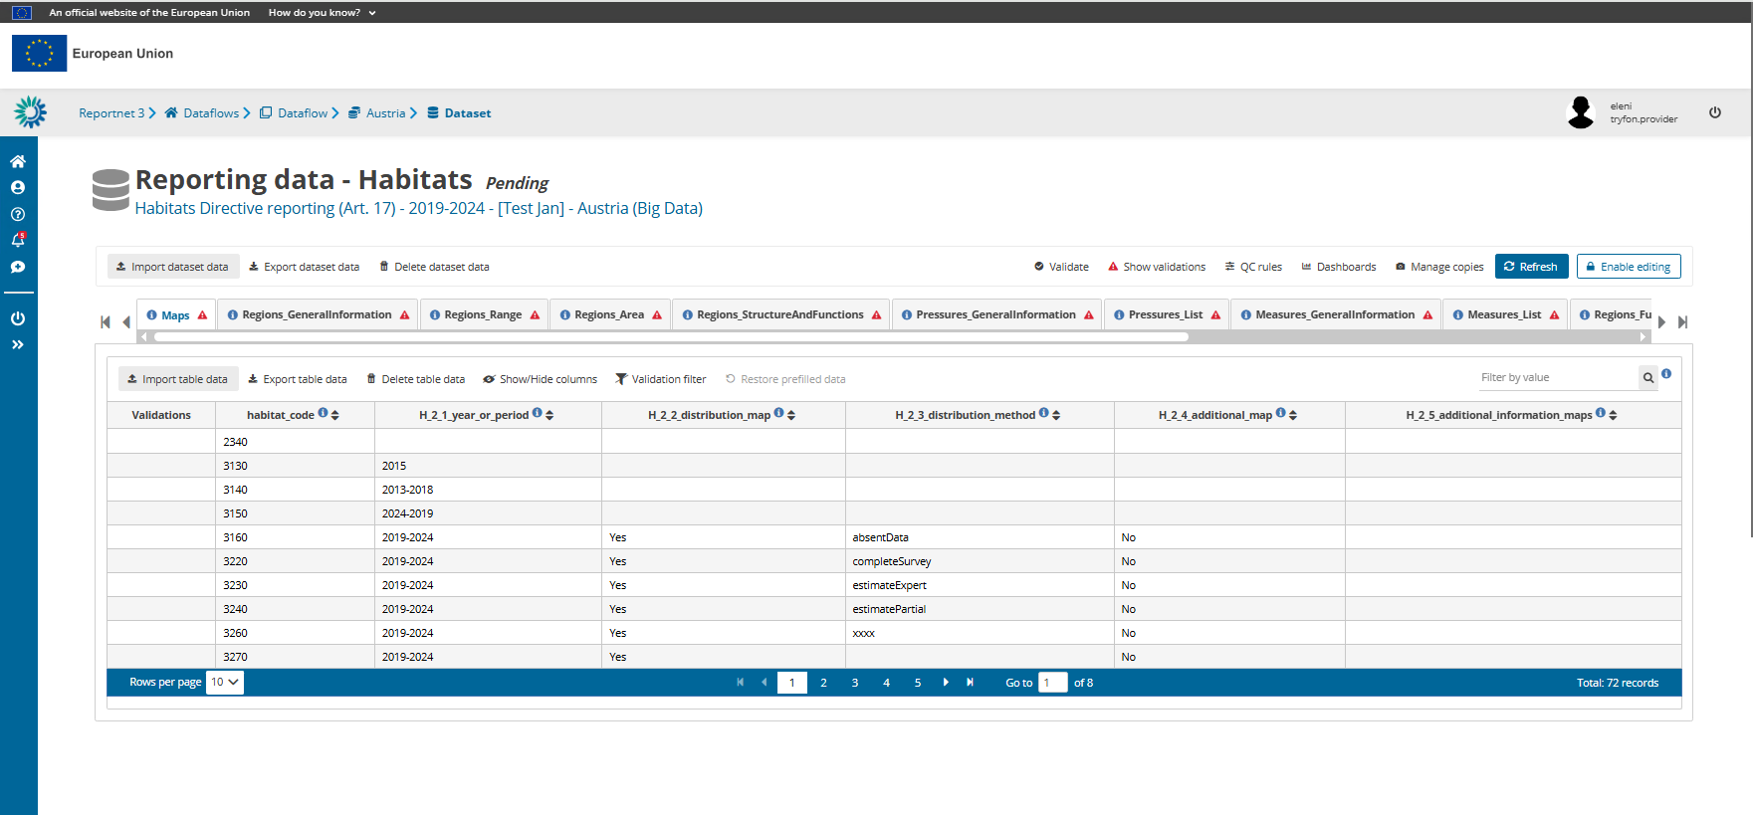

Slide 42
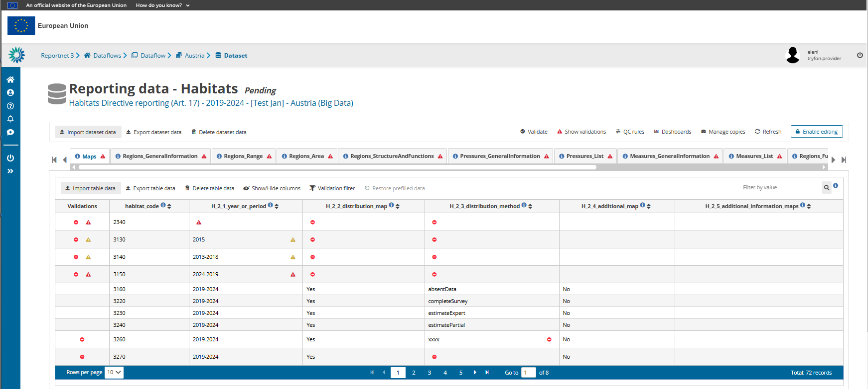

Slide 43
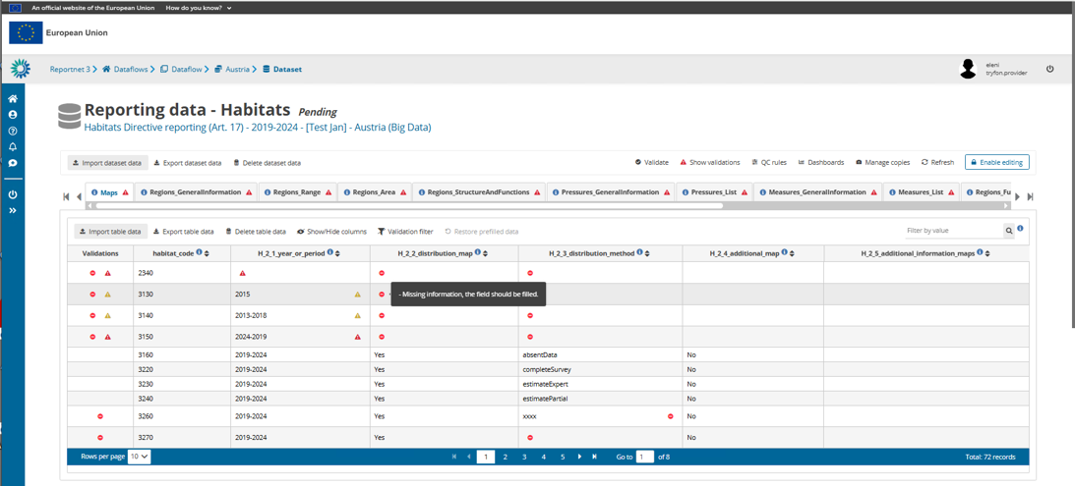

Slide 44
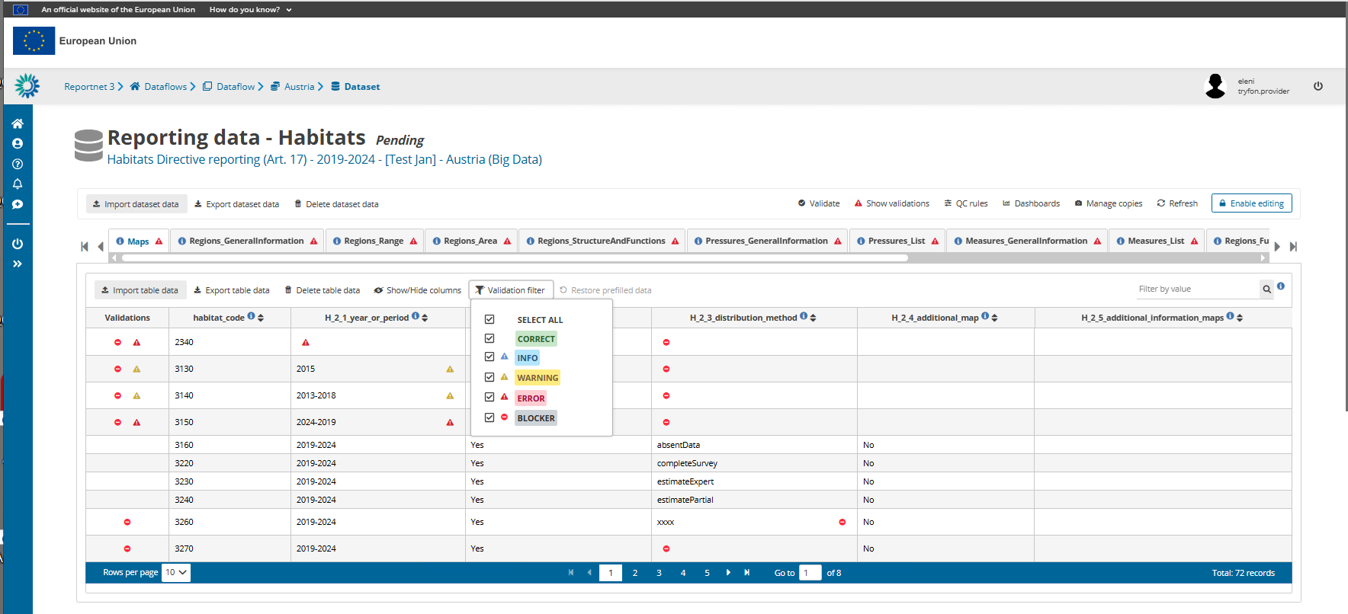

Slide 45
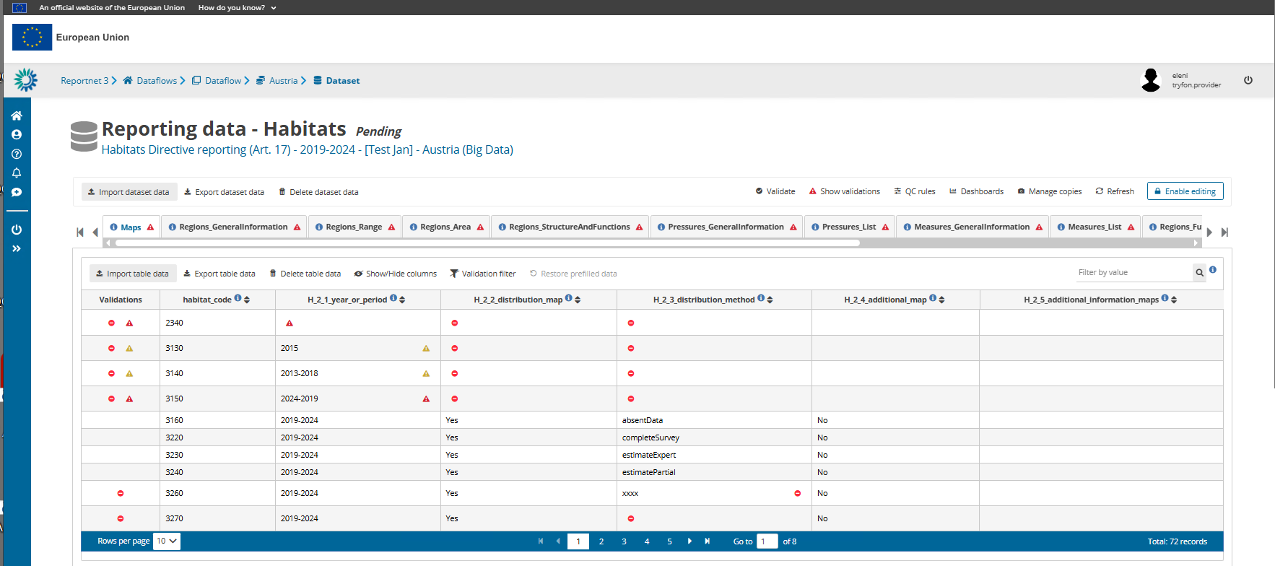

Slide 46
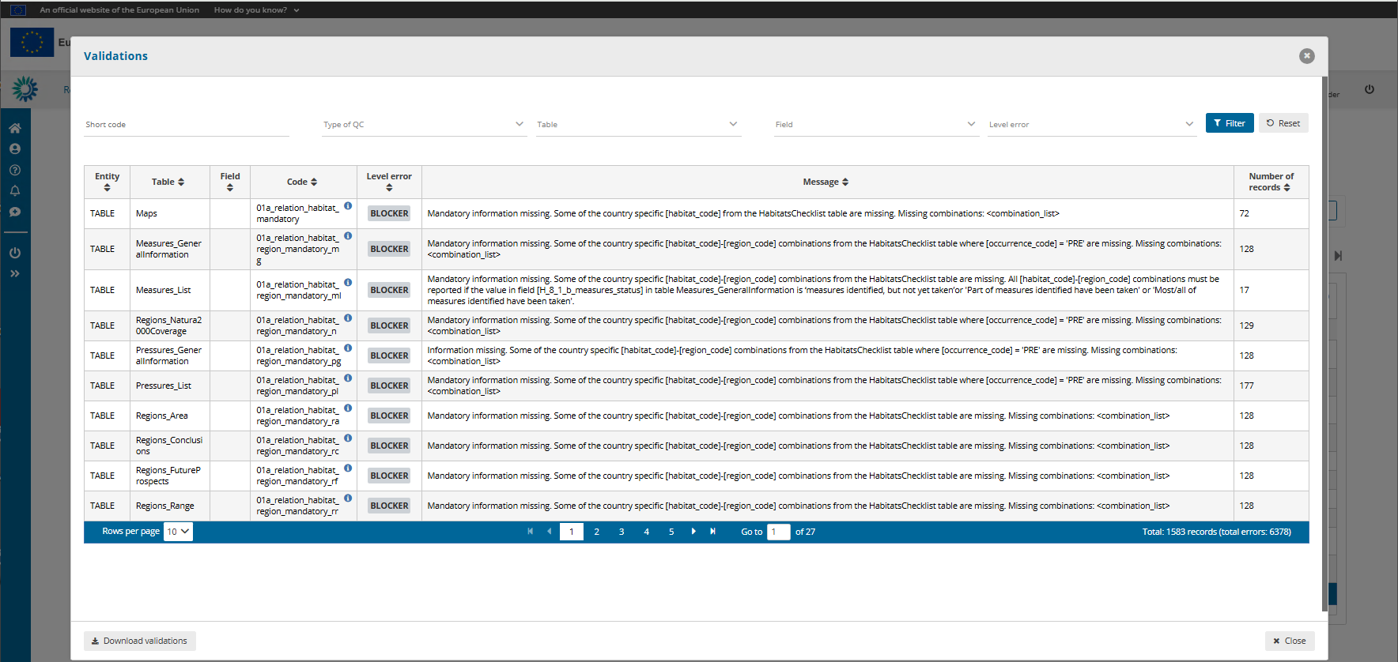
Table functionality: Click on a record and it will take you back to the reporting table and apply a filter to show only those records with QC result

Slide 47
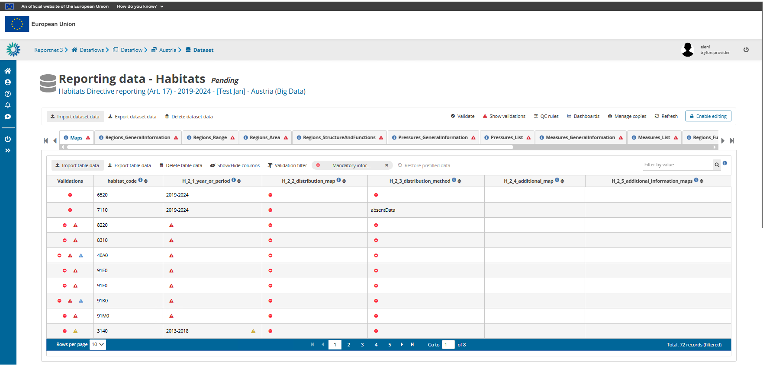

Slide 49
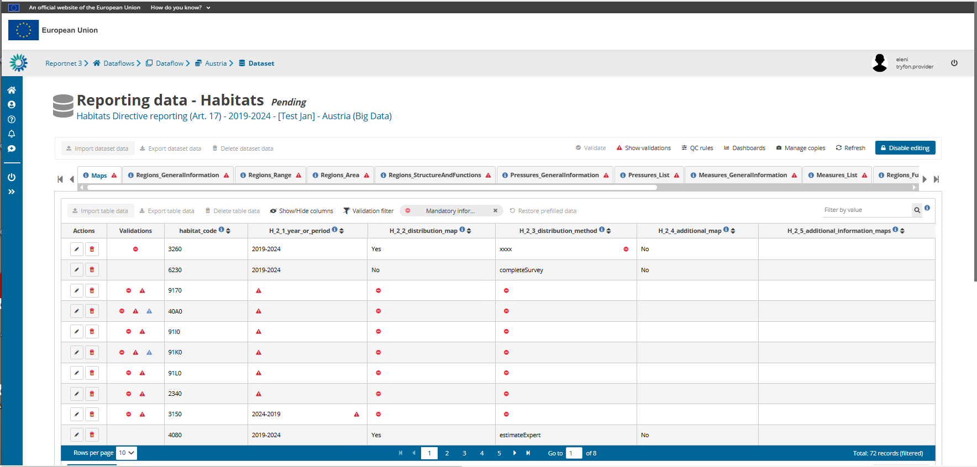

Slide 50
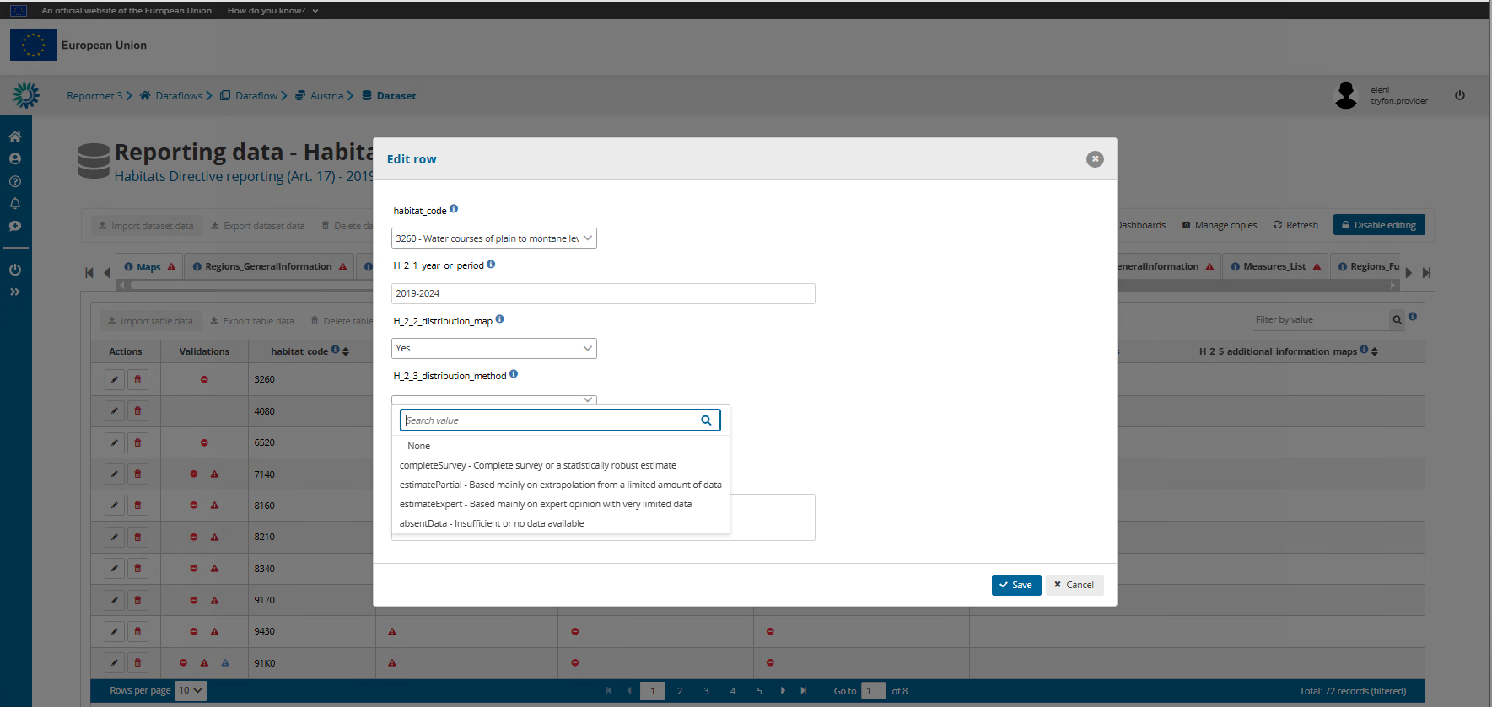

Slide 51
Validation is done at schema level but there are interlinked tables between different schemas, this means validations may involve more than one tables and schemas – coordination of reporters necessary
Unresolved Blockers do not allow delivery
NOTE: Required fields in the schema vs Mandatory fields in the Reporting Format
Required fields at schema level => BLOCKER or ERROR
Non-required fields may have blockers from QC rules
Mandatory fields in the reporting format => BLOCKER or ERROR through QC rules
Empty mandatory tables -> BLOCKER
Incorrect use of all Reference data values -> BLOCKER

Slide 52
Releasing your data submission

Slide 53
Delivery step revalidates data in all schemas and if no Blockers encountered then a copy of the data is delivered to EEA

Slide 54
Open deliveries are strongly encouraged
Spatial data are by default restricted from public view

Slide 56
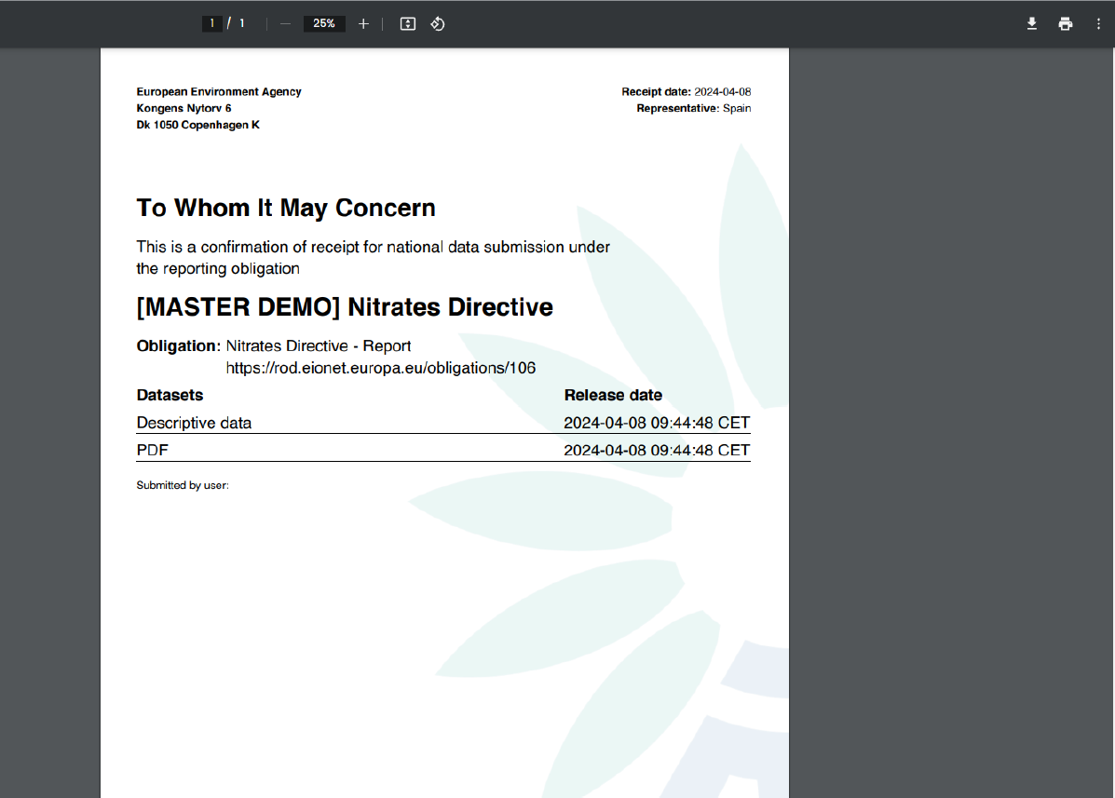
Example of confirmation receipt. It will be similar for Art. 17

Slide 57
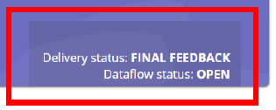

Slide 58
Technical acceptance follows

Slide 59
Thank you
nature.helpdesk@eionet.europa.eu
© Dominika Hrašková, REDISCOVER Nature/EEA

